Slide 1

Faculty of Engineering & Technology
Computer science Department
Database System
-COMP333-
First semester 2021-2022
Course Project

Slide 2

Pharmacy Management System
The pharmacy management system, is a system that stores data and enables functionality that organizes and maintains the medication use process within pharmacies and the work of employees and the categories that contain items from several
supplying companies, making orders and
discounting through insurance and
financial management.

Slide 3
Group Team info.
Group number: 11
Student’s names and IDs:
Eyab Ghifari | 1190999
Mohamad Alwan | 1181192
Islam Jihad | 1191375
Ibrahim Asfour | 1190985
Instructor's Name: Dr. Diaeddin Rimawi

Slide 4
The System Functions
Orders
Items
Categories
Employees
Insurance
Provide Company

Slide 5
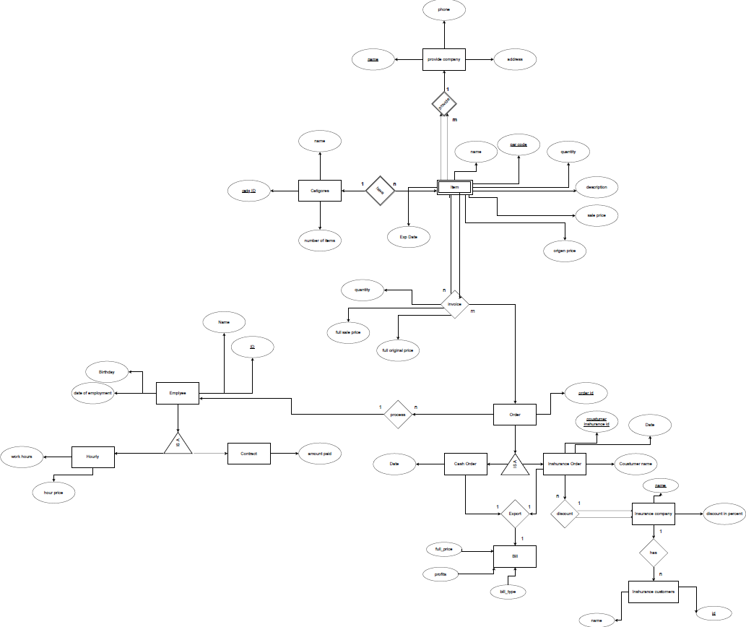
ERD Diagram

Slide 6
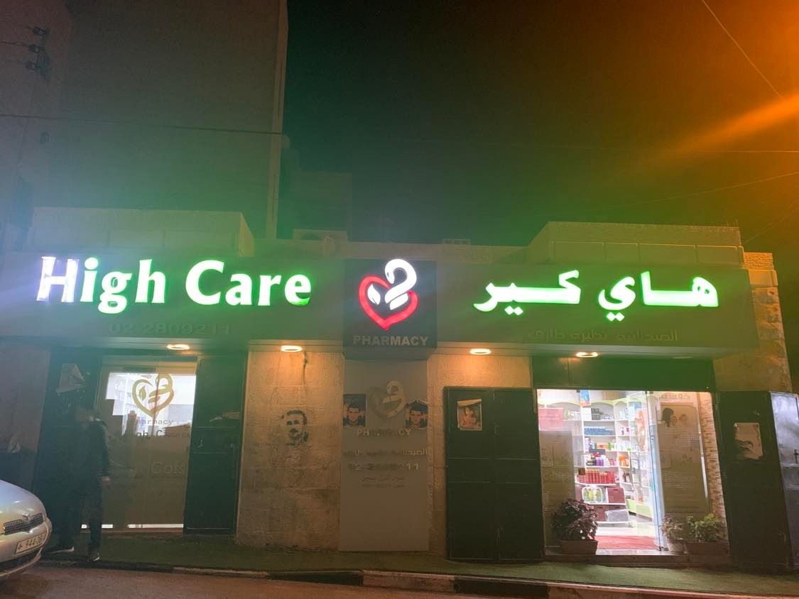
Client
Nathera Alwan

Slide 7
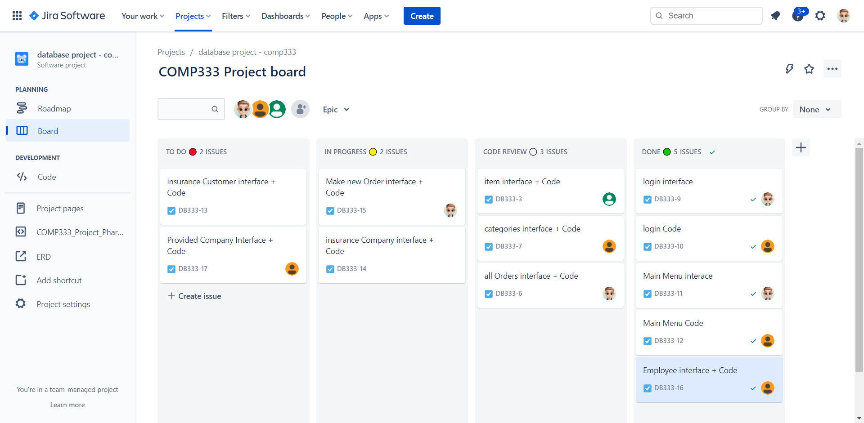
Teamwork Management

Slide 8
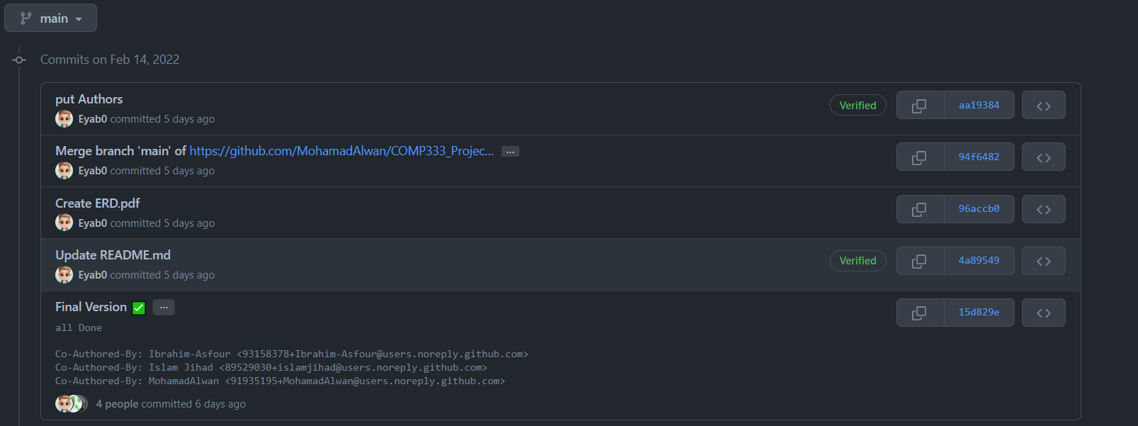
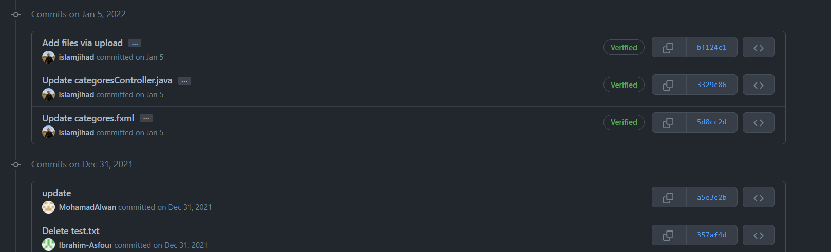
Teamwork Management

Slide 9
Eyab Ghifari Work
Login Interface
Main Menu Interface
All Orders Interface + Code
Make new Order interface + Code
Message Interface + Code (Ok,Error,Warning)

Slide 10
Mohamad Alwan Work
Login Code
Main Menu Code
Categories interface + Code
Employees interface + Code
Provided Company interface + Code

Slide 11
Islam Jihad Work
Item Interface
Item Code

Slide 12
Ibrahim Asfour Work
Insurance Customers Interface
Insurance Customers Code
Insurance Company interface
Insurance Company Code

Slide 13



Technology
programming language and compiler
ui technology

Slide 14
We Hope You Like our
Project !

